Slide 1



Presentation of the equipment and tools for Renewable energy resources in the STE(A)M classroom
&
How to introduce STE(A)M topic Renewable energy resources in the STE(A)M classroom?

Slide 2
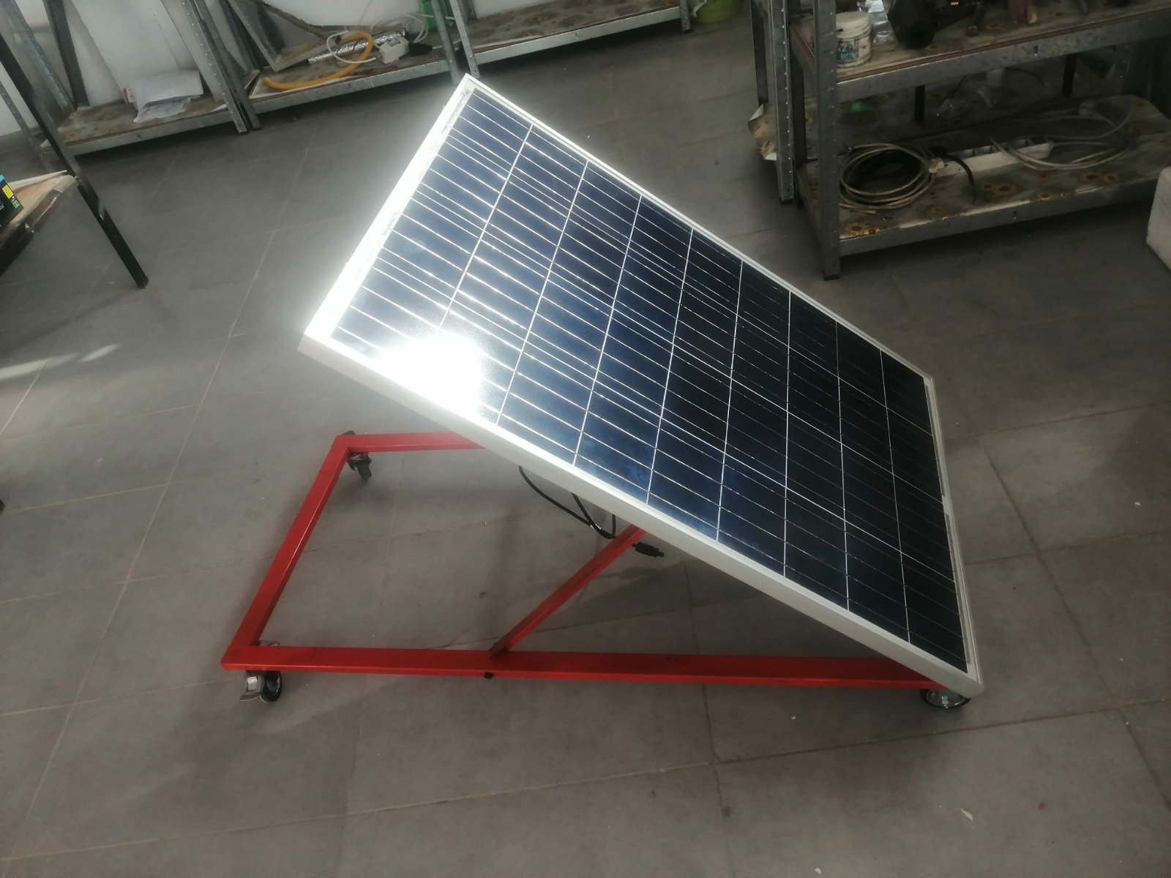
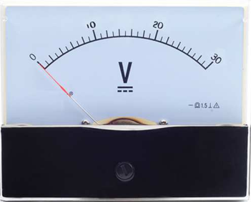

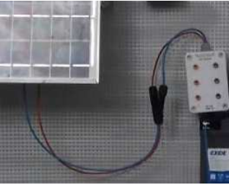
1. Model of PV solar system
Movable metal construction base, with 4 wheels covered with perforated metal sheet, painted, 1.25 m length x 0.5 m width x 0.55 m height
Polycrystalline PV solar panel, power at least 100 W, 12 V, with build-in rotation mechanism
Voltmeter for direct current, with measuring range up to 20V, placed in plastic box and quick switching couplings (on and off)
Small plastic house with no sharp edges, 6 x 5 x 4 cm. Open windows, integrated 12V LED lighting
Connection set.

Slide 3
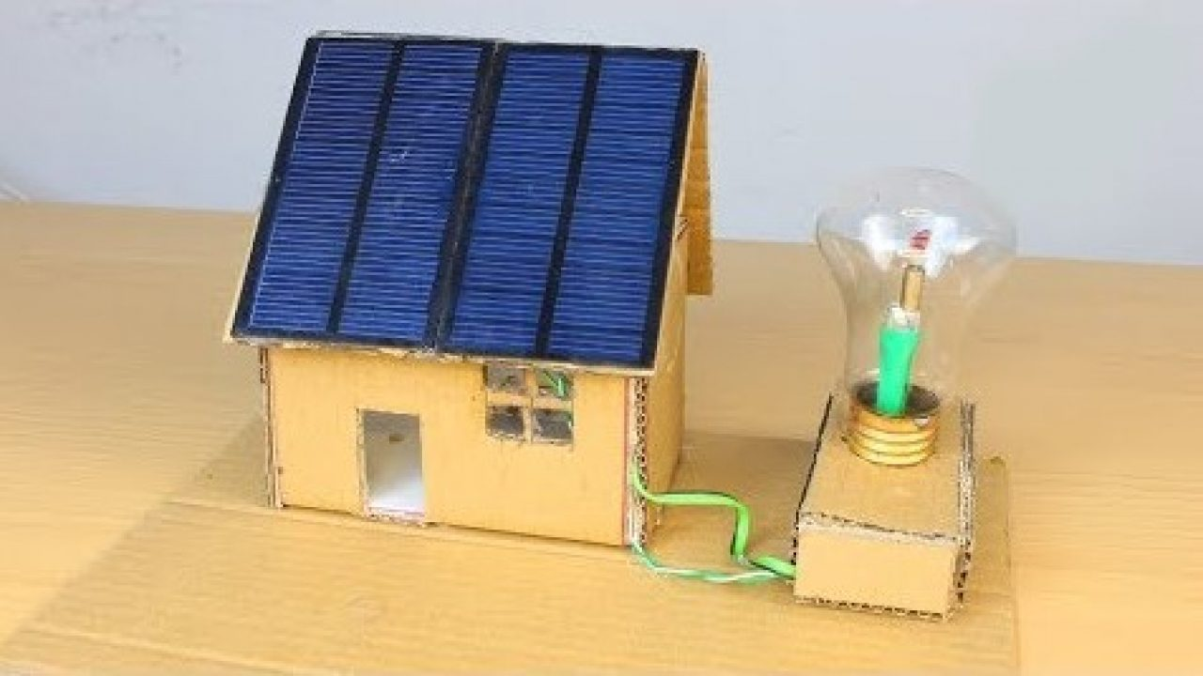
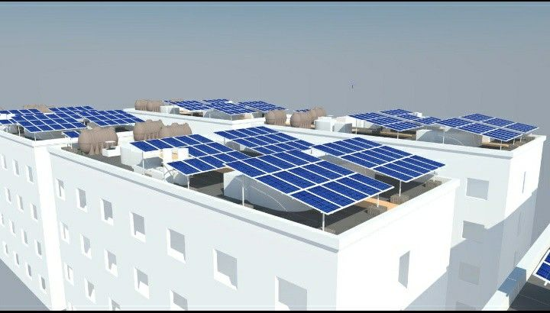
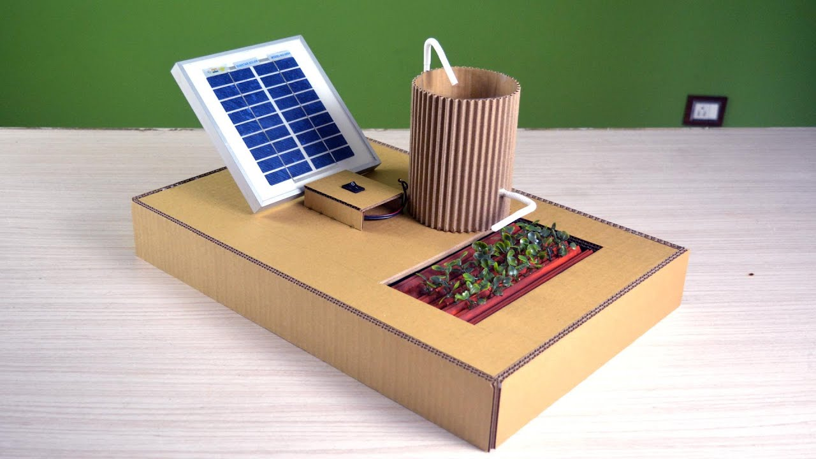
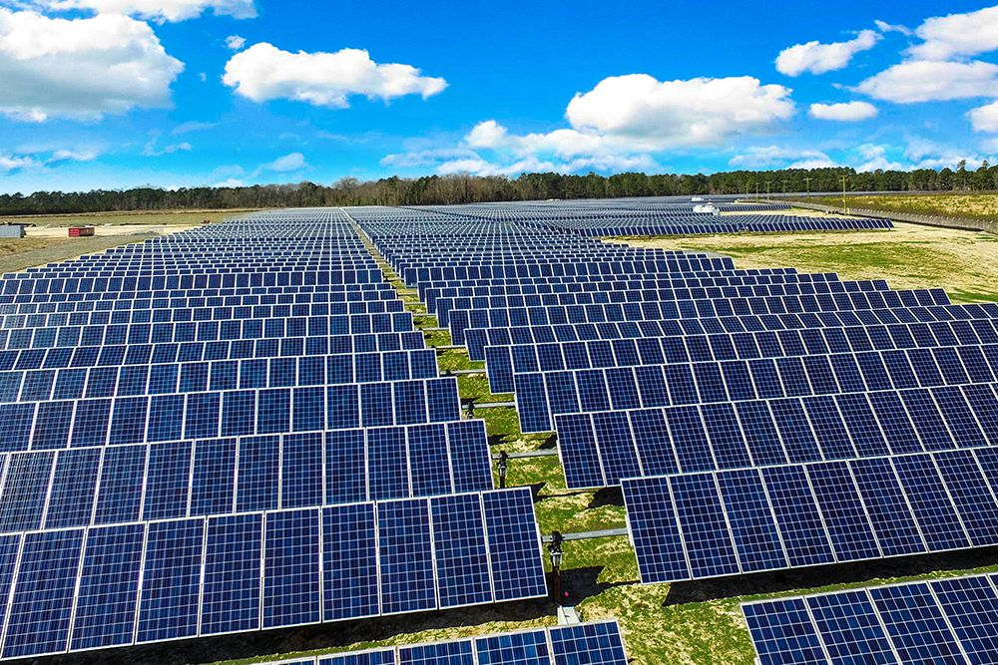

Slide 4
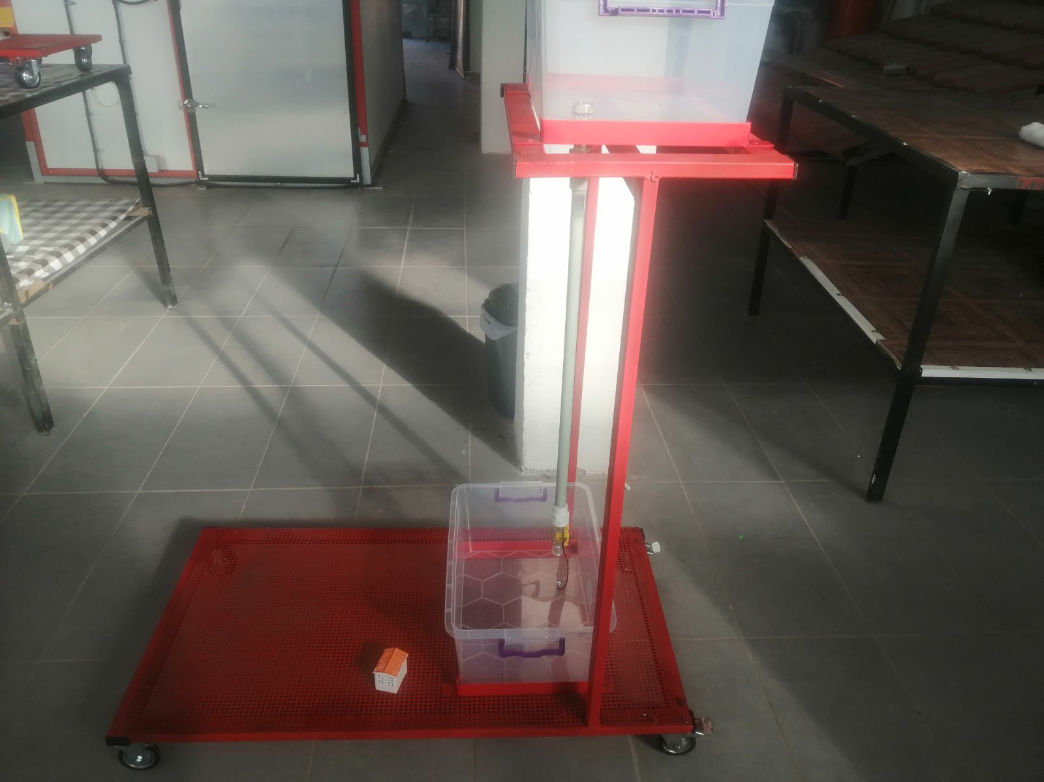
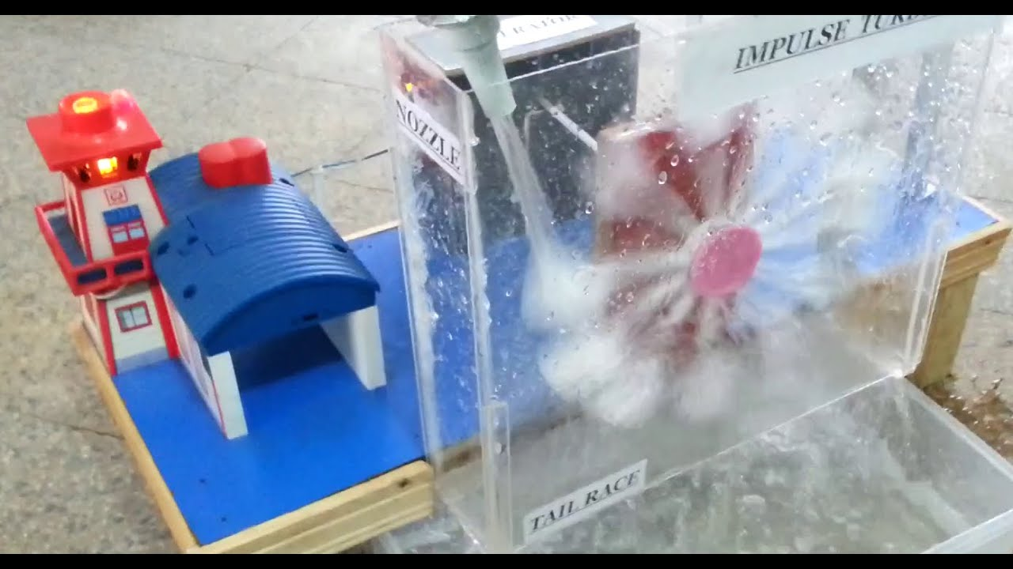
2. Hydropower plant model
Movable metal construction base, with 4 wheels covered with perforated metal sheet, painted, 1.25 m length x 0.5 m width x 0.55 m height
Mini water turbine with connections
Water tank with capacity of 10 litters
Small plastic house with no sharp edges, 6 x 5 x 4 cm. Open windows, integrated 12V LED lighting
Connection set

Slide 5
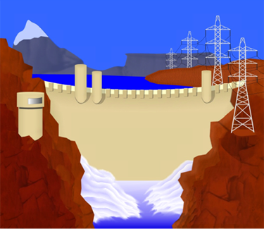
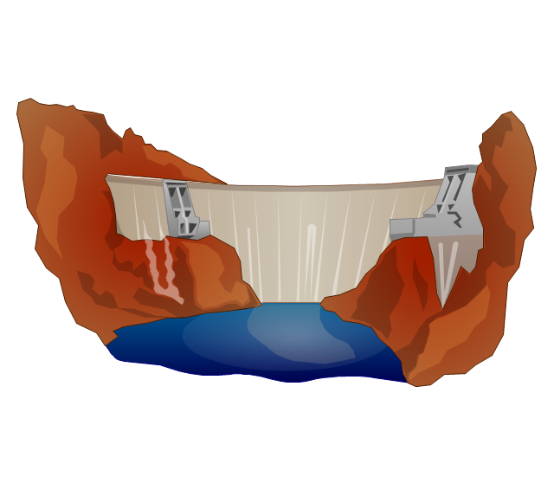
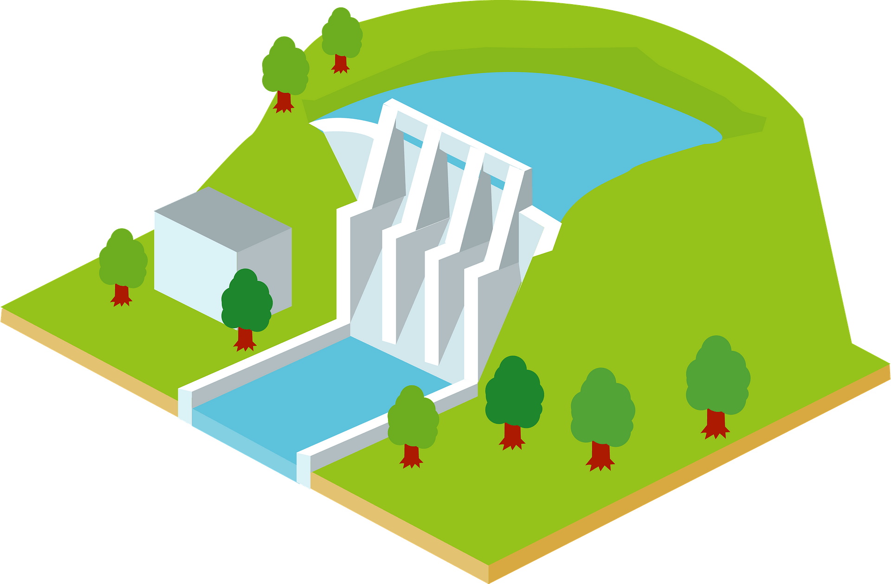
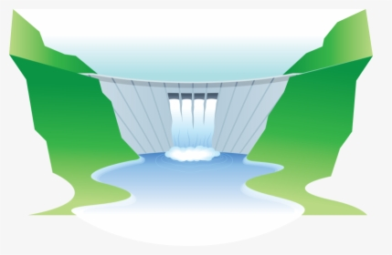

Slide 6
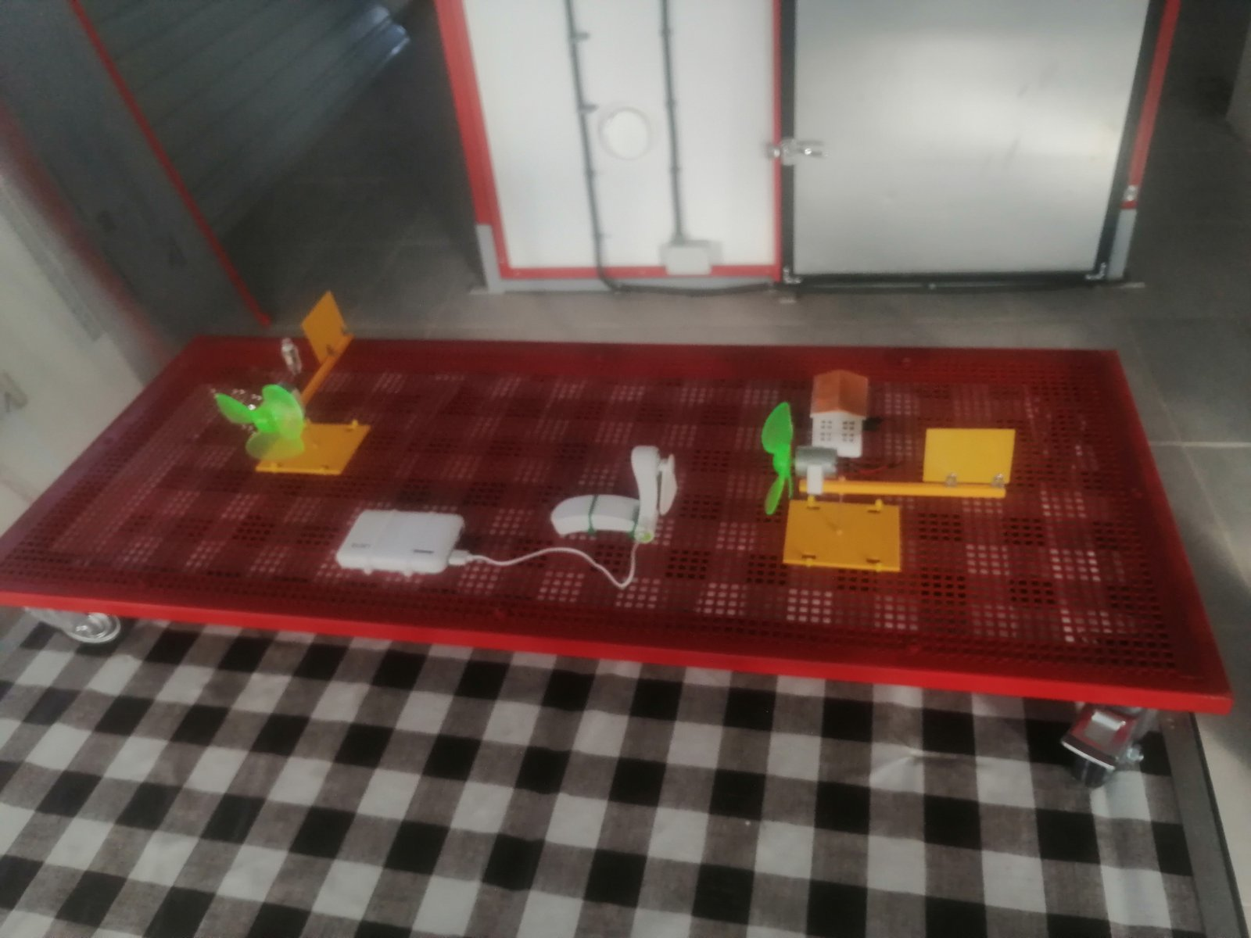
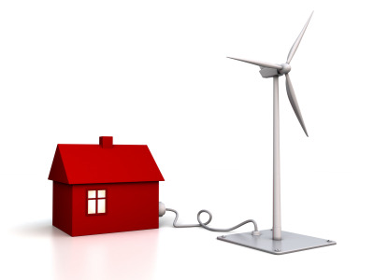
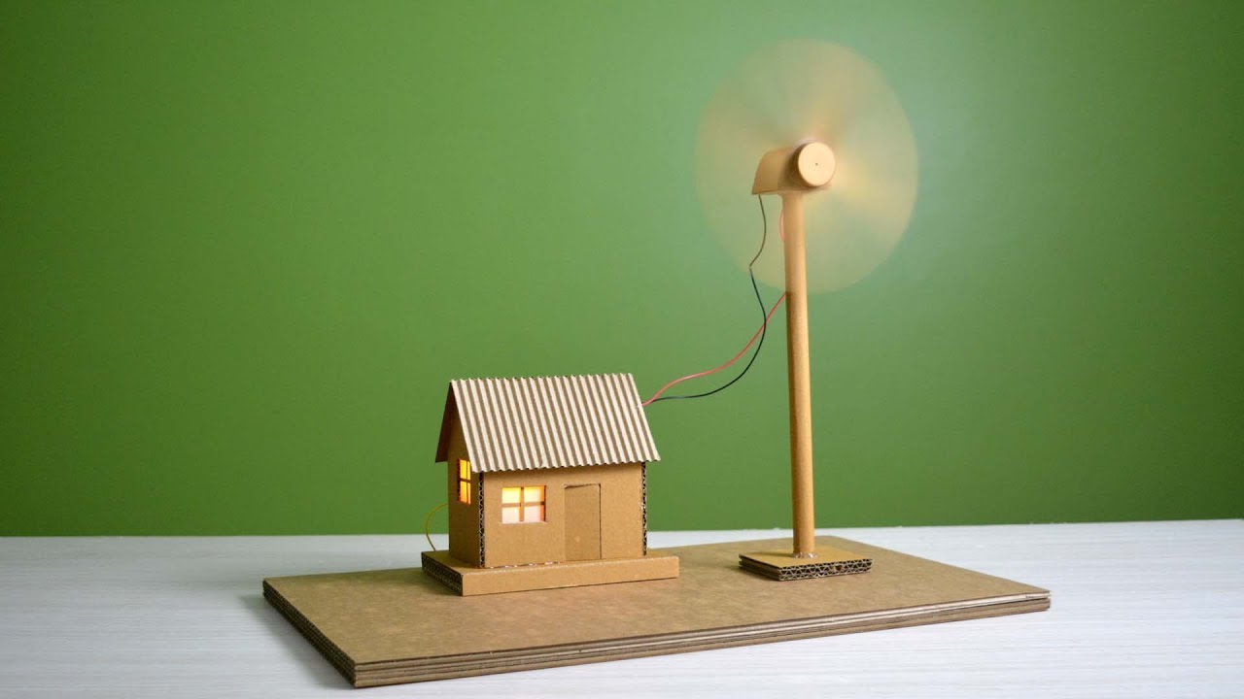
3. Wind-power plant model
Movable metal construction base, with 4 wheels covered with perforated metal sheet, painted, 1.25 m length x 0.5 m width x 0.55 m height
Fan of 12V
Indoor battery of 12V and 9 Ah
Wind turbine
Small plastic house with no sharp edges, 6 x 5 x 4 cm. Open windows, integrated 12V LED lighting
Connection set

Slide 7
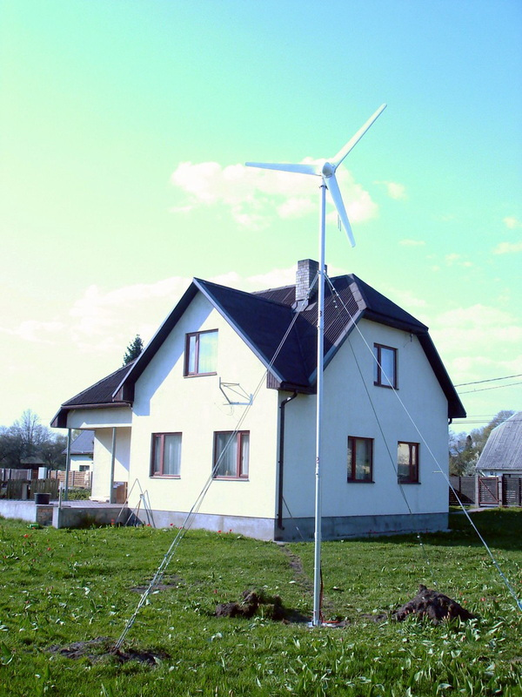
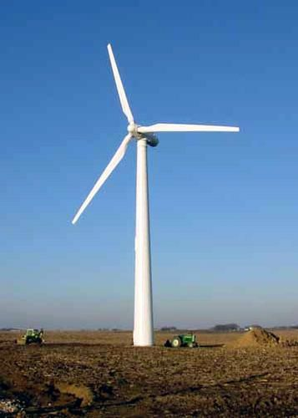
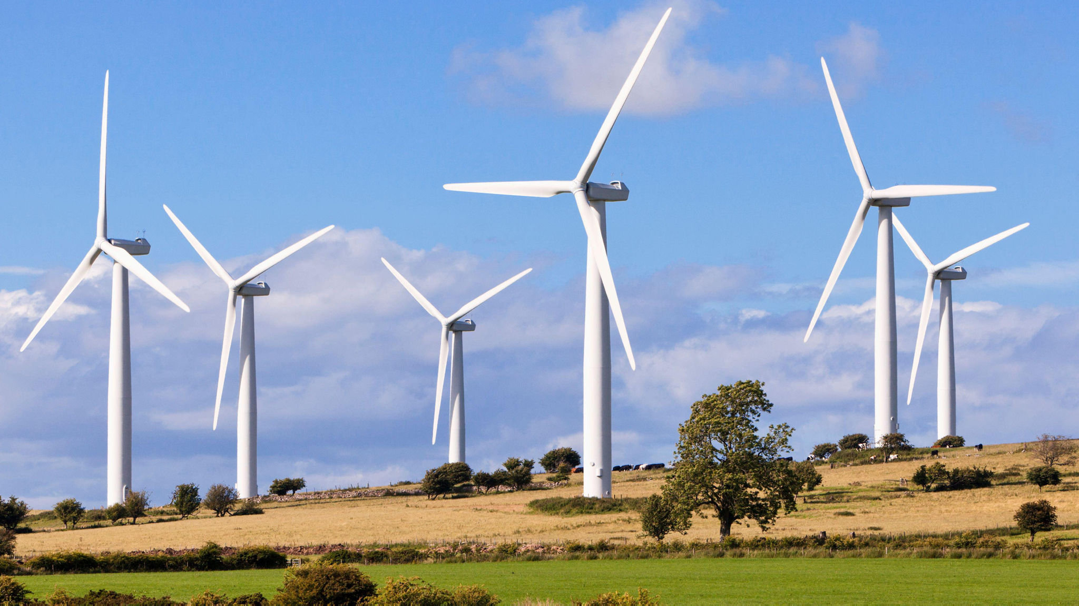
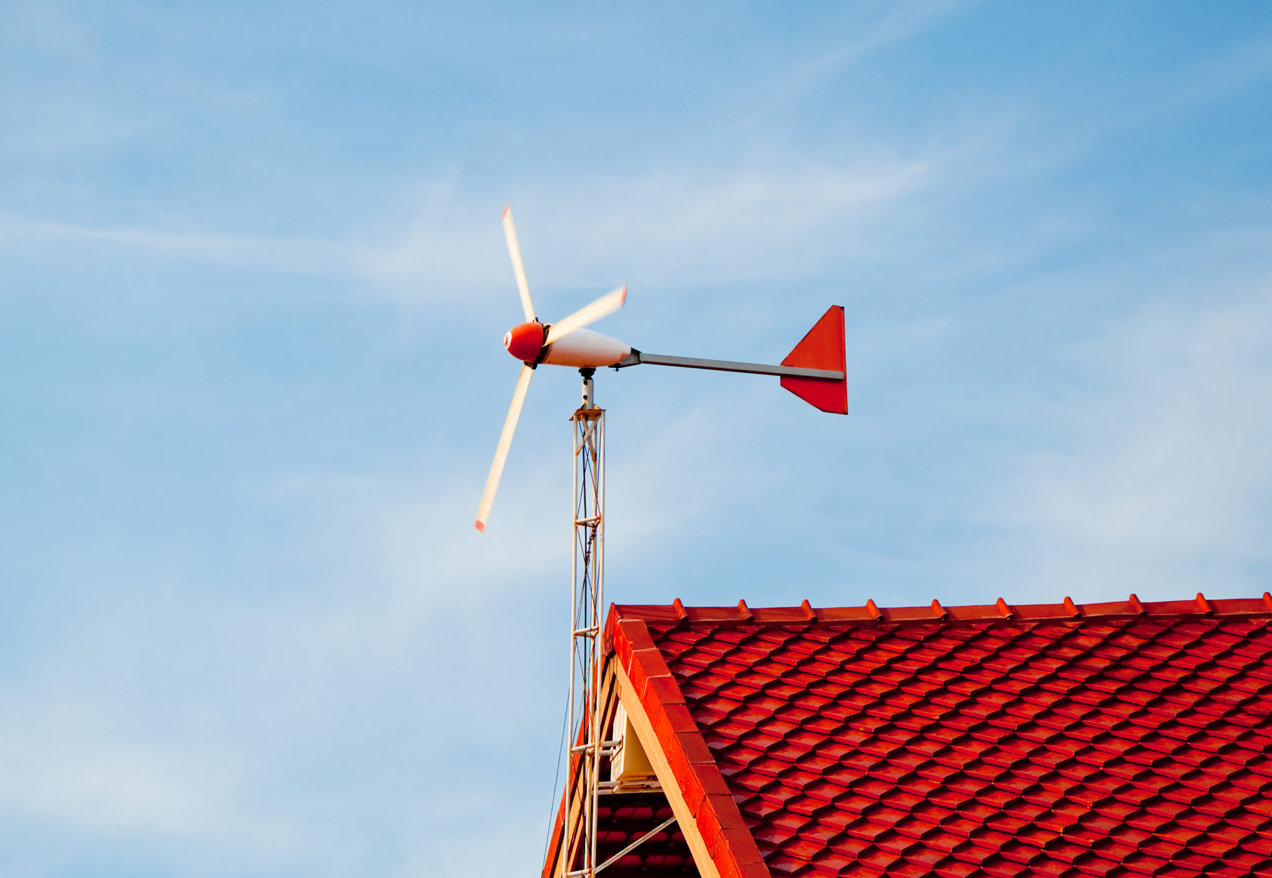
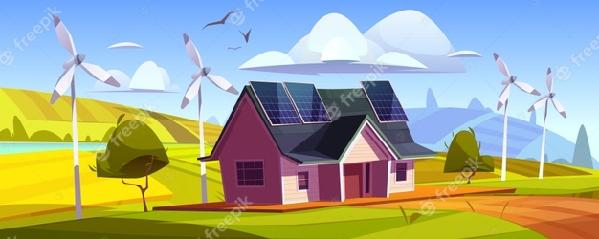

Slide 8
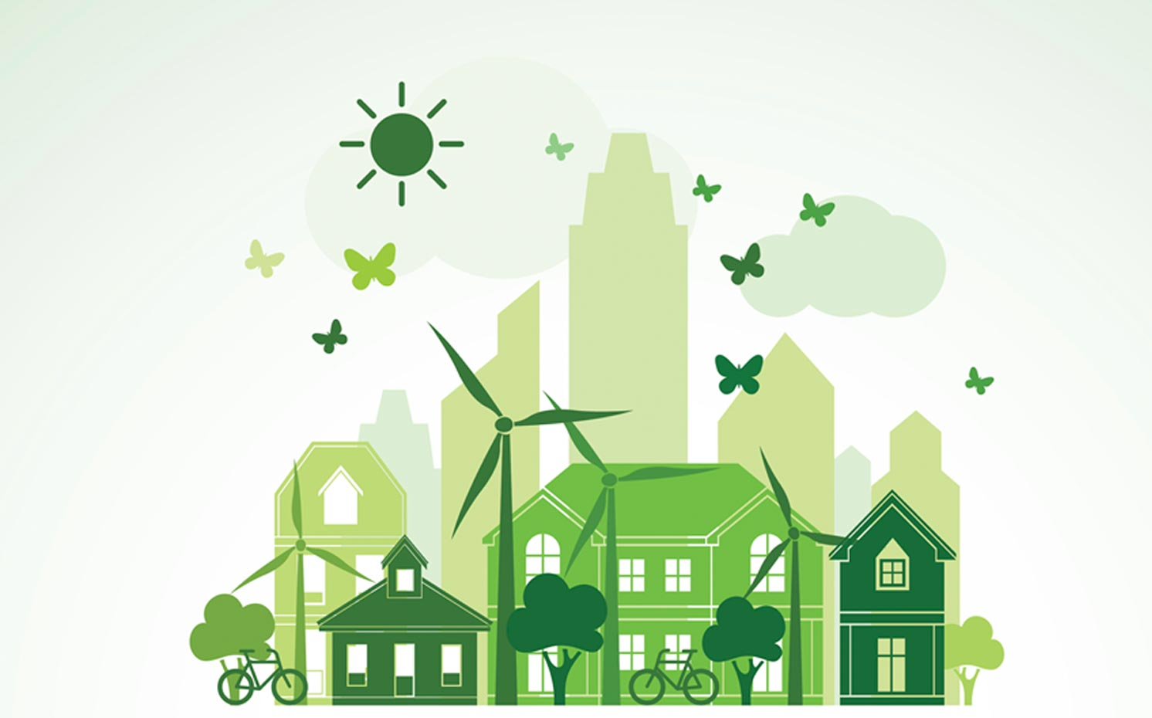

Slide 9
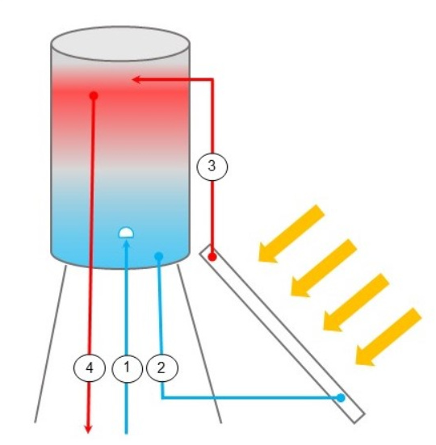
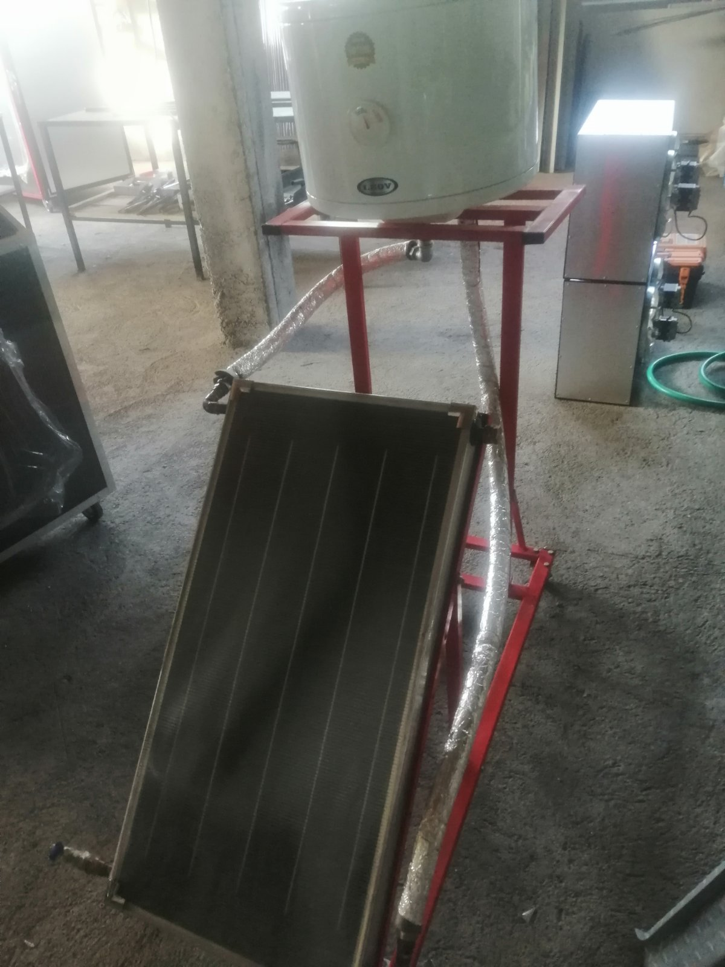
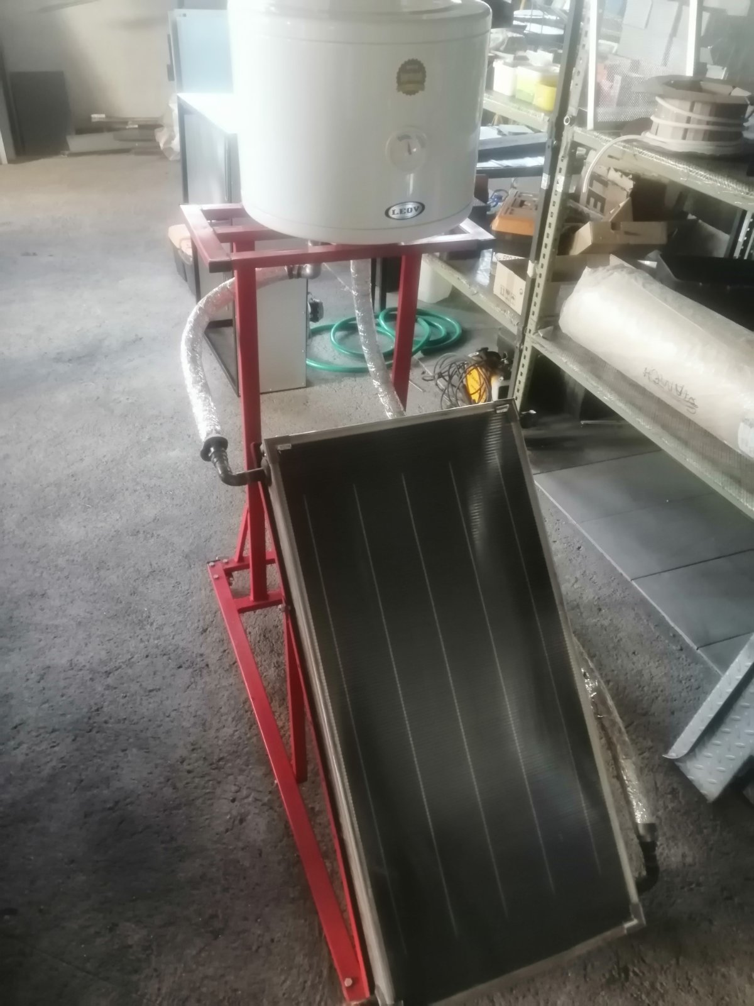
4. Model of solar thermal system
Movable metal construction base, with 4 wheels covered with perforated metal sheet, painted, 1.25 m length x 0.5 m width x 0.55 m height
Thermal solar collector 0.5 x 1 m
Thermometer with LCD display and 2 temperatures to measure (10 x 10 cm)
Water tank of 30 litters
Connection set

Slide 10
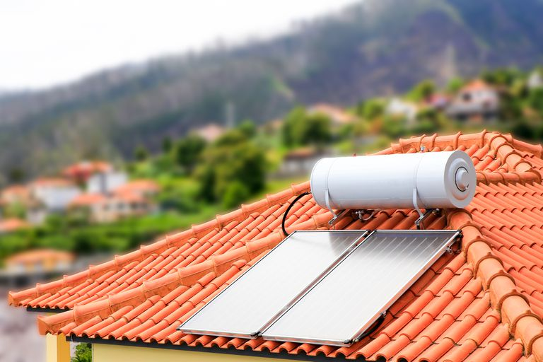
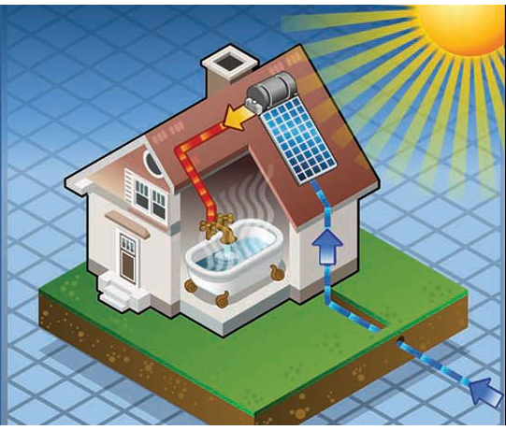
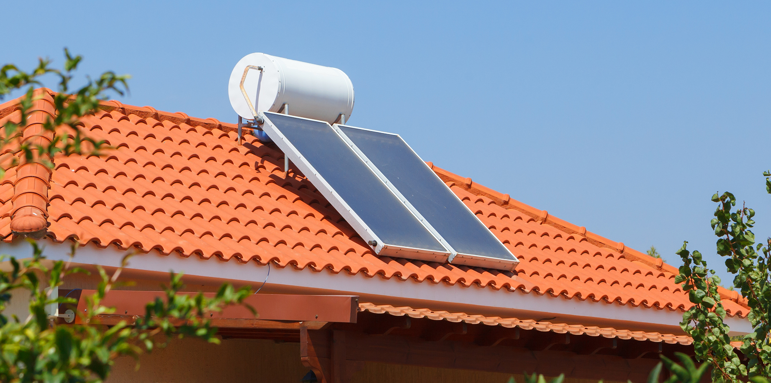

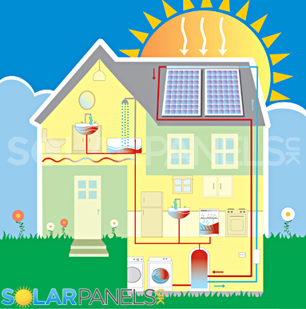
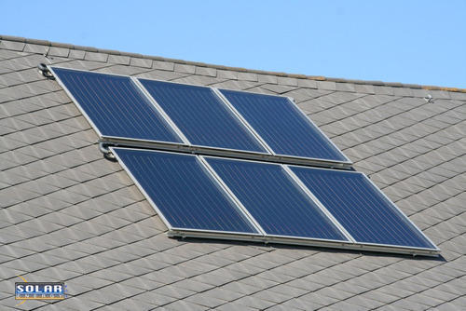
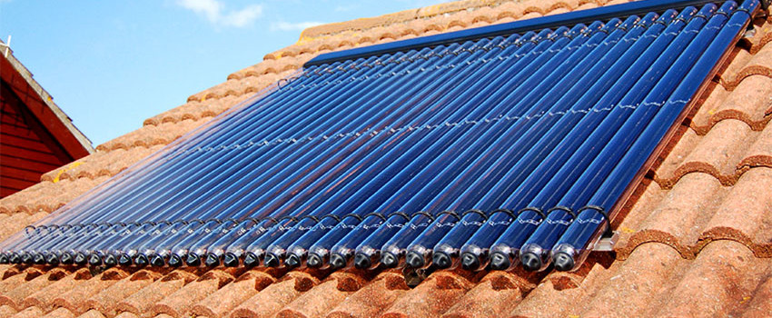

Slide 11
