Slide 1











Kindergarten "Edelweiss" - Velingrad
STE(A)M KIDS
2020-1-HR01-KA201-077710

Slide 2






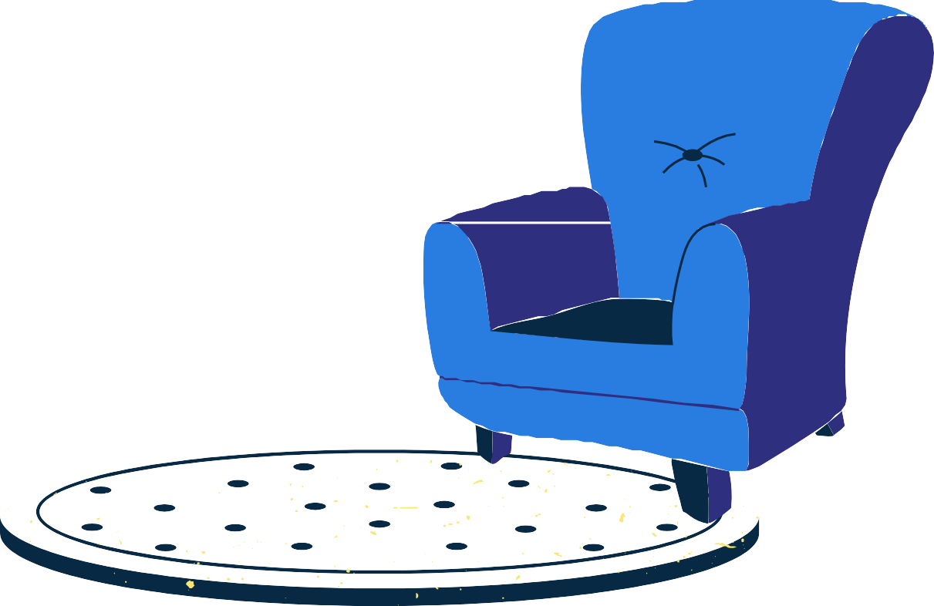





“STE(A)M kids”
RESPONSE TO FUTURE MARKET TRENDS, FAST DEVELOPMENT AND CHANGES IN THE SOCIO-ECONOMIC PLAN AND SCIENTIFIC AND TECHNICAL PROGRESS

Slide 3



Main goal
to include the best expert knowledge in the daily learning process in kindergartens

Slide 4




DEVELOPING OWN AND INNOVATIVE EDUCATIONAL APPROACH FOR STEAM CLASSROOM
Topics: Renewable Energy Sources (RES),
Science,
Energy efficiency and environmental protection, Art
STEAM DESIGN AND IMPLEMENTATION
CLASSROOM
experiential learning, learning by doing and teamwork
Specific
goals
TRANSNATIONAL COOPERATION IN THE FIELD OF EDUCATION
eTwinning and creating a long-term partnership strategy

Slide 5


Croatia,
01/11/2020Г. -
31/10/2022
Bulgaria,
Northern Macedonia,
Turkey.
9 different socio-economic organizations (public body; educational institutions; NGOs,
business)

Slide 6

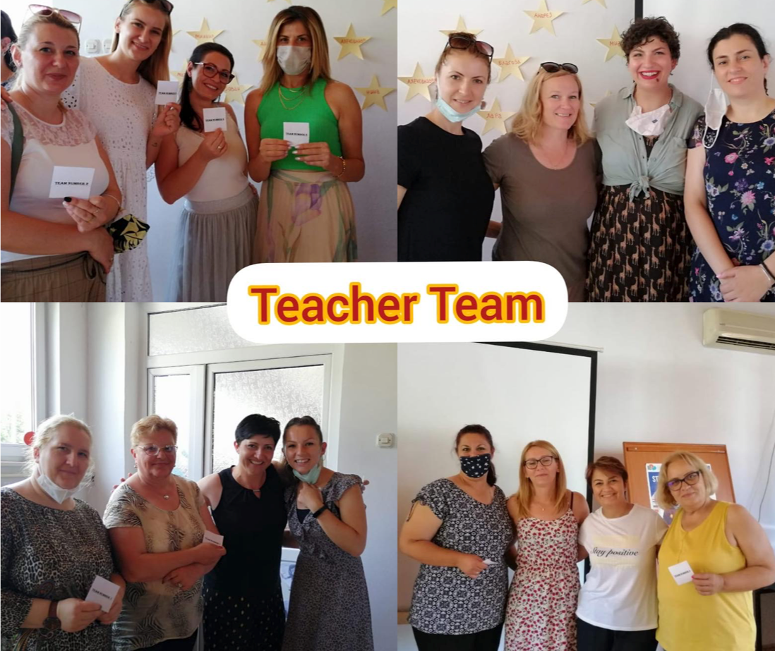
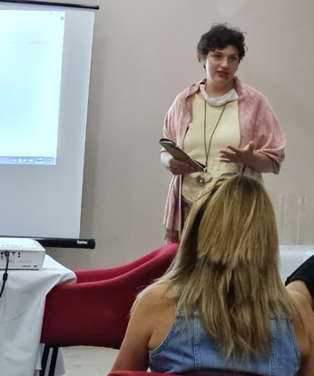
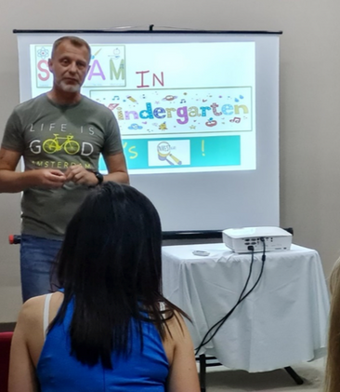
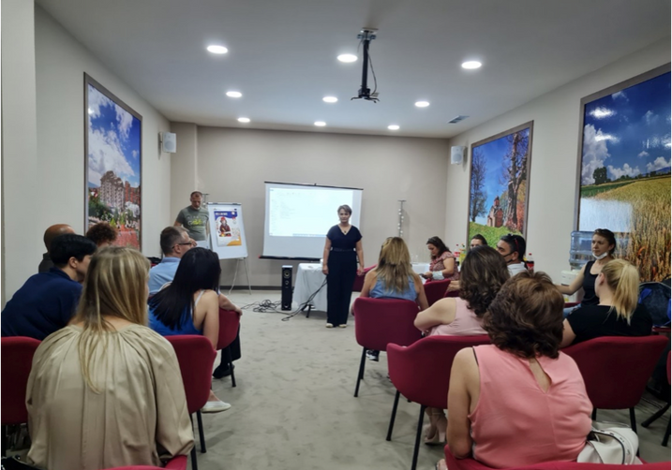


1st short-term training
MACEDONIA,KOCHANI
27.06 - 01.07.2021
STE(A)M KIDS

Slide 7

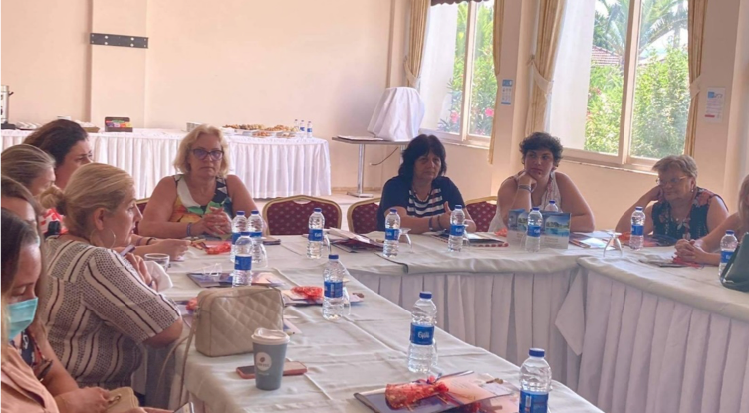
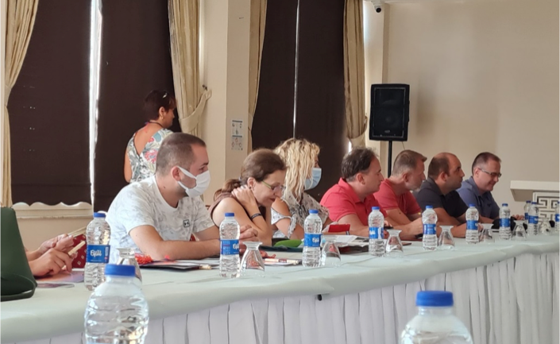
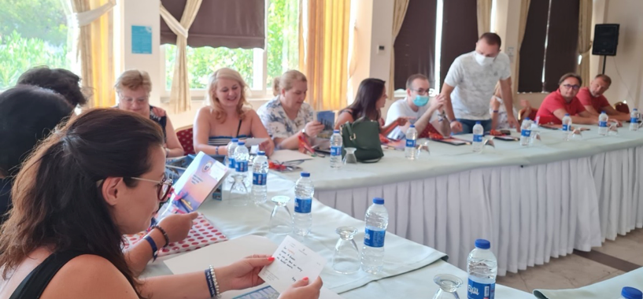
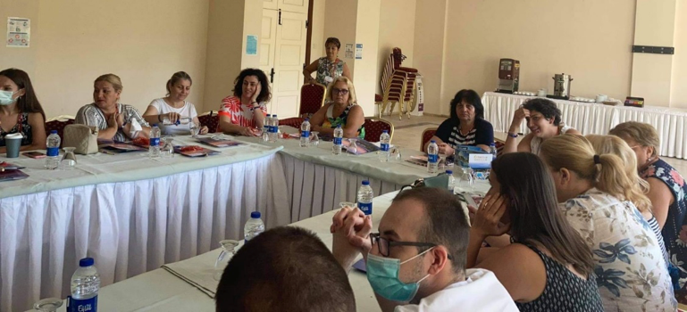
2nd short-term training
TURKEY,
STE(A)M KIDS
Kusadasi
25 -30.07.2021

Slide 8

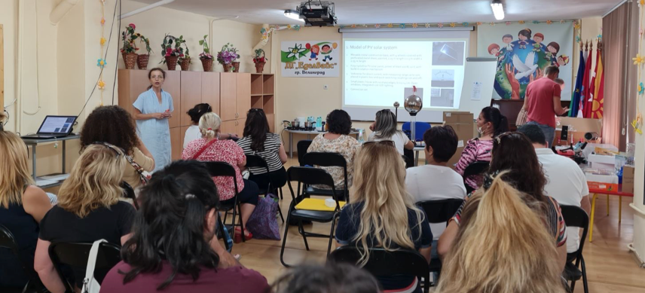
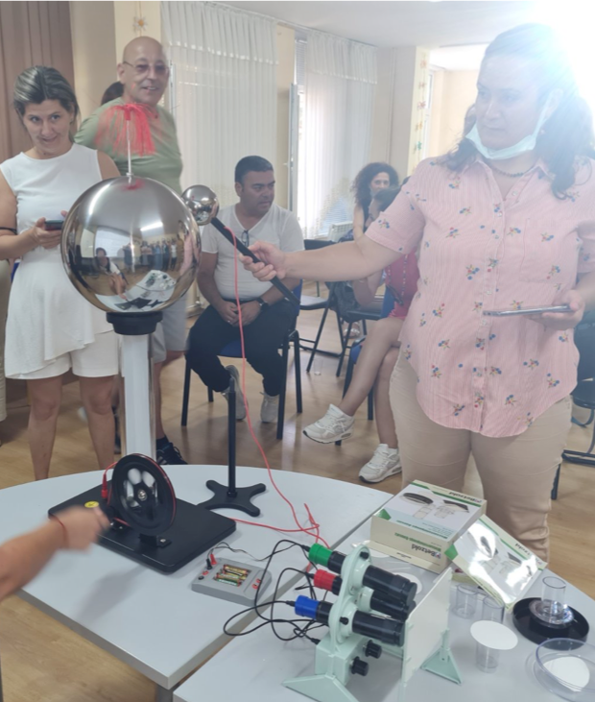
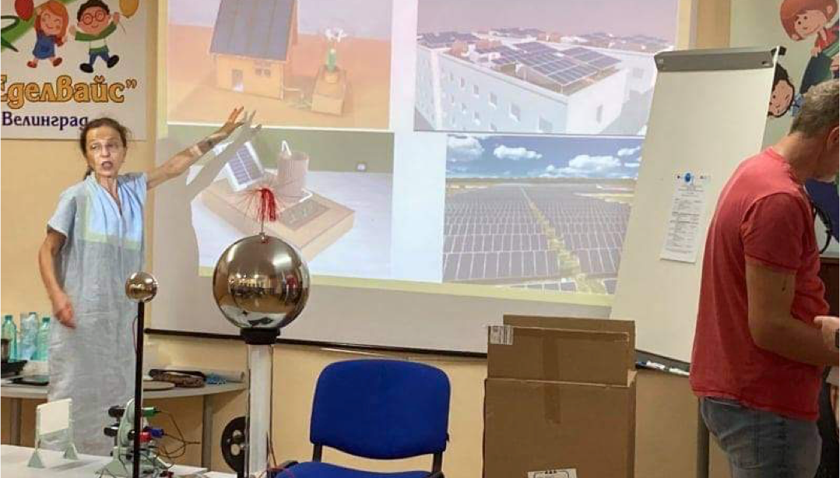
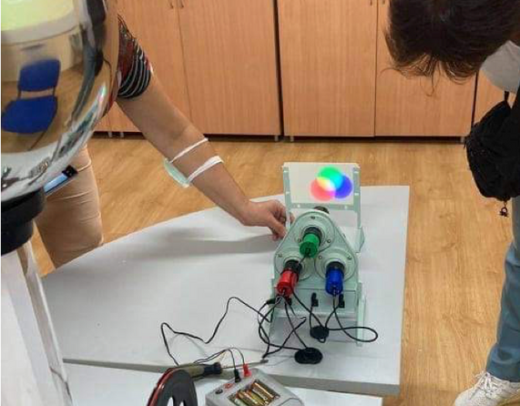

3rd short-term training
STE(A)M KIDS
BULGARIA, VELINGRAD
08 -13.08.2021

Slide 9

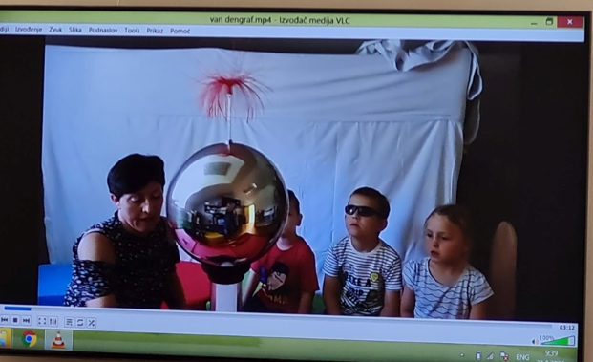
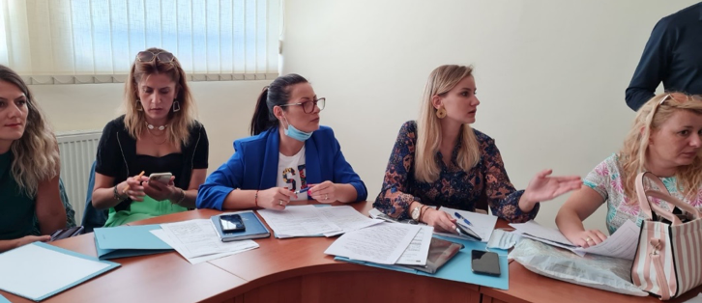
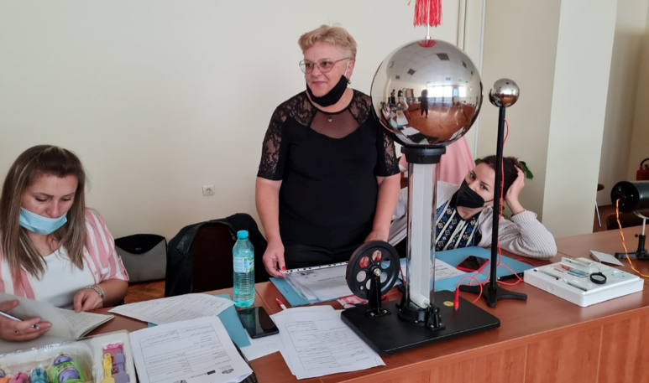
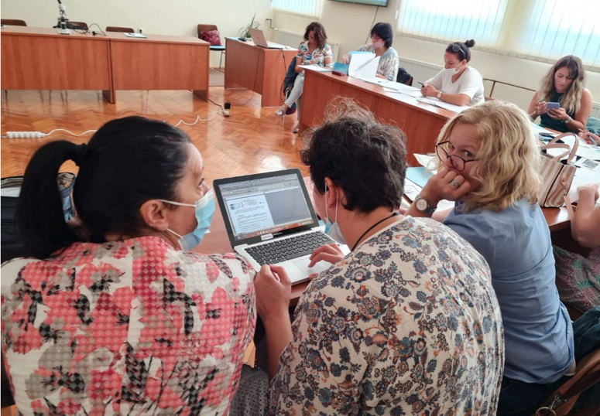


4th short-term training
STE(A)M KIDS
CROATIA, LUDBREG
30.08 -
03.09.2021

Slide 10







STEAM activities and teaching tasks
https://www.facebook.com/profile.php? id=100052548159574
TEACHER =
FACILITATOR
CENTERED AROUND CHILDREN
SURPRISE, AWARDS, PRAISE
Constructivism
the process is important, children are discoverers
competitions

Slide 11

Benjamin Frankenstein
Tell me and I will forget, teach me and I can remember, include me and I will learn.

Slide 12























free access
http://steamkidsproject.eu/about/
https://www.facebook.com/profile.php?id=100052548159574 https://dg-edelvais-vd.com/za-nas/

Slide 13




Thank you for your attention!
Marina Grancharova
EMAIL ADDRESS
MOBILE NUMBER
CONSULTATION HOURS
cdg_edelvais@abv.bg
+359 897 391 375
9 PM to 16 PM

